Slide 1
CST8250
Indexes and Views

Slide 2
Overview
Indexes
Purpose of Indexes
Indexes defined
Index file organization
Types of indexes
Rules for indexes
SQL examples for indexes
Views
Views defined
View example
Types of views
SQL examples for views

Slide 3
Indexes

Slide 4
Purpose of Indexes
Most queries only require a small amount of information from a database
What if the only way to get the information was to search the ENTIRE database – INEFFICIENT!
Indexes help us speed up our queries so we don’t have to search the entire database

Slide 5
Indexes Defined
Analogy: Instead of searching an entire textbook for the page we’re looking for, we have an index at the back of the book that allows us to look up the topic and page number.
Definition: A data structure that is used to speed up data retrieval. It typically contains a list of keys used to identify columns in tables.

Slide 6
Indexes Defined (cont.)
Index: a table or other data structure used to determine in a file the location of records that satisfy some condition
Primary keys are automatically indexed
Other fields or combinations of fields can also be indexed; these are called secondary keys (or nonunique keys)

Slide 7
Indexes
Create an index on name:
B+ trees have fan-out of 100s: max 4 levels !
Adam | Betty | Charles | …. | Smith | ….
Notes:
In an indexed file organization, the records are stored either sequentially or nonsequentially, and an index is created that allows the application software to locate individual records (see Figure 5-7b). Like a card catalog in a library, an index is a table that is used to determine in a file the location of records that satisfy some condition. Each index entry matches a key value with one or more records. An index can point to unique records (a primary key index, such as on the ProductID field of a product record) or to potentially more
than one record. An index that allows each entry to point to more than one record is called a secondary key index.

Slide 8
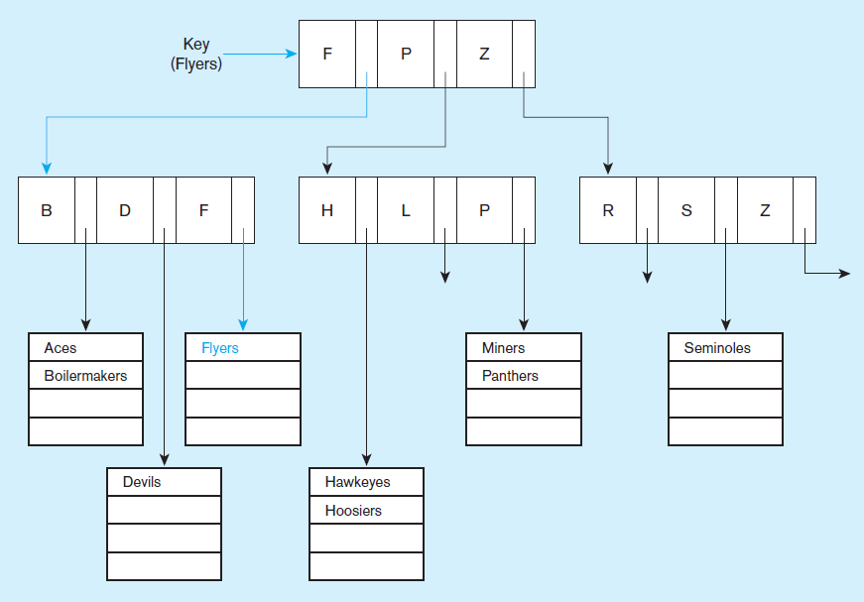
Indexed file organization
uses a tree search
Average time to find desired record based on depth of the tree and length of the list
Notes:
In an indexed file organization, the records are stored either sequentially or nonsequentially, and an index is created that allows the application software to locate individual records (see Figure 5-7b). Like a card catalog in a library, an index is a table that is used to determine in a file the location of records that satisfy some condition. Each index entry matches a key value with one or more records. An index can point to unique records (a primary key index, such as on the ProductID field of a product record) or to potentially more
than one record. An index that allows each entry to point to more than one record is called a secondary key index.
An advantage of the indexed file organization over the sequential is that it is easier to insert and delete data. Because the index is composed of many smaller lists of actual data items (seen in the bottom of the tree), then sorting an individual cluster is much less costly than sorting the whole file. Also, if you keep the individual lists small enough, then even if they are unsorted, the search time is not so bad.
The trick is indexing, and specifically keeping an optimal number of levels within the index. In this case we see two levels of indexing, below which are the sublists of data items.
The index organization in this figure splits at the top level into three groups. Any team name starting with A-F goes in the first group, those with G-P in the second, and those with Q-Z in the third. Within each group there is a second split into three subgroups each.
Indexed file organization is often used with attributes that are likely to be frequently used in queries. Part of the physical design process involves choosing which columns of a table to index, as we’ll see later.

Slide 9
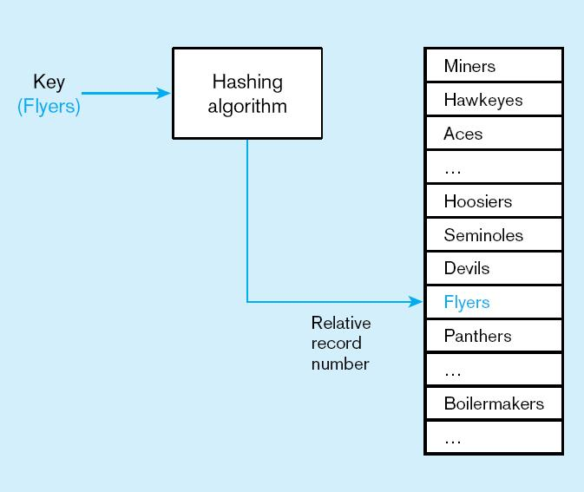
Hashed file organization
Hash algorithm
Usually uses division-remainder to determine record position. Records with same position are grouped in lists.
Notes:
A hashing algorithm is a routine that converts a primary key value into a record address. Although there are several variations of hashed files, in most cases the records are
located nonsequentially, as dictated by the hashing algorithm. Thus, sequential data processing is impractical.
A typical hashing algorithm uses the technique of dividing each primary key value by a suitable prime number and then using the remainder of the division as the relative storage location. For example, suppose that an organization has a set of approximately 1,000 employee records to be stored on magnetic disk. A suitable prime number would be 997, because it is close to 1,000. Now consider the record for employee ID 12396. When we divide this number by 997, the remainder is 432. Thus, this record is stored at location 432 in the file.
Hashing algorithms could potentially map two different primary keys to the same location. If that happens, there will be a list at that location, similar to the lists in the indexed file organization described earlier.

Slide 10

Unique and Nonunique Indexes
Unique (primary) Index
Typically done for primary keys, but could also apply to other unique fields
Nonunique (secondary) index
Done for fields that are often used to group individual entities (e.g. zip code, product category)
Notes:
Part of the physical design process is to decide which fields need indexing. Primary keys are normally indexed by default. The database designer typically chooses which other fields to index, based on expected usage of those fields in queries and inserts. It the fields are used a lot as conditions in queries, this increases the importance of indexing. But indexing comes at a cost, which involves maintaining the index. Indexes are costly for fields that get updated a lot.

Slide 11
Rules for Using Indexes
Use on larger tables
Index the primary key of each table
Index search fields (fields frequently in WHERE clause)
Fields in SQL ORDER BY and GROUP BY commands
When there are >100 values but not when there are <30 values

Slide 12
Rules for Using Indexes (cont.)
Avoid use of indexes for fields with long values; perhaps compress values first
If key to index is used to determine location of record, use surrogate (like sequence number) to allow even spread in storage area
DBMS may have limit on number of indexes per table and number of bytes per indexed field(s)
Be careful of indexing attributes with null values; many DBMSs will not recognize null values in an index search

Slide 13
Creating Indexes
Syntax:
CREATE INDEX nameIndex ON Person(name)

Slide 14
Creating Indexes
Indexes can be created on more than one attribute:
Example:
CREATE INDEX doubleindex ON Person (age, city)
SELECT * FROM Person WHERE age = 55 AND city = “Seattle”
Helps in:
SELECT * FROM Person WHERE city = “Seattle”
But not in:

Slide 15
Creating Indexes
Indexes can be useful in range queries too:
B+ trees help in:
Why not create indexes on everything?
CREATE INDEX ageIndex ON Person (age)
SELECT * FROM Person WHERE age > 25 AND age < 28

Slide 16
Views

Slide 17
Defining Views
Views are relations, except that they are not physically stored.
For presenting different information to different users
Employee(ssn, name, department, project, salary)
Payroll has access to Employee, others only to Developers. This means that we can control what developers see in the view and confidential information is protected.
CREATE VIEW Developers AS
SELECT name, project
FROM Employee
WHERE department = “Development”

Slide 18
Create View in MySQL
Note that views always contain up to date information. They are loaded at run time every time the query is run.
CREATE VIEW view_name AS
SELECT column1, column2, …..
FROM table_name
WHERE condition;

Slide 19
A Different View
Person(name, city)
Purchase(buyer, seller, product, store)
Product(name, maker, category)
We have a new virtual table:
Seattle-view(buyer, seller, product, store)
CREATE VIEW Seattle_view AS
SELECT buyer, seller, product, store
FROM Person JOIN Purchase ON Person.per-name = Purchase.buyer
WHERE Person.city = “Seattle”

Slide 20
A Different View
We can later use the view:
SELECT name, store
FROM Seattle_view, Product
WHERE Seattle_view.product = Product.name AND
Product.category = “shoes”

Slide 21
What Happens When We Query a View?
A view is not a true table, it does not contain data
When we query a view, it accesses the source table to capture the data
This means that if data needs to be modified, it must be modified at the table level

Slide 22
What Happens When We Query a View?
SELECT name, Seattle_view.store
FROM Seattle_view
JOIN Purchase ON Seattle_view.product = Product.name
WHERE Product.category = “shoes”
SELECT name, Purchase.store
FROM Person
JOIN Purchase ON Person.per-name = Purchase.buyer
JOIN Product ON Purchase.product = Product.name
WHERE Person.city = “Seattle” AND
Person.name = Purchase.buyer AND
Purchase.poduct = Product.name AND
Product.category = “shoes”

Slide 23
Types of Views
Virtual views:
Used in databases
Computed only on-demand – slower at runtime
Always up to date
Materialized views
Used in data warehouses
Precomputed offline – faster at runtime
May have stale data

Slide 24
Updating Views
How can I insert a tuple into a table that doesn’t exist?
Employee(ssn, name, department, project, salary)
CREATE VIEW Developers AS
SELECT name, project
FROM Employee
WHERE department = “Development”
If we make the
following insertion:
INSERT INTO Developers VALUES(“Joe”, “Optimizer”)
It becomes:
INSERT INTO Employee VALUES(NULL, “Joe”, NULL, “Optimizer”, NULL)

Slide 25
Updating Views in MySQL
Many methods to update views.
The first below will replace the view with new changes in the query
The second will update a value in the source table
CREATE OR REPLACE VIEW view_name AS SELECT column1, column2, ... FROM table_name WHERE condition;
UPDATE view_name SET column1=value WHERE condition;

Slide 26
Non-Updatable Views
How can we add the following tuple to the view?
(“Joe”, “Shoe Model 12345”, “Nine West”)
We need to add “Joe” to Person first, but we don’t have all its attributes. The update will fail.
For MySQL specific requirements to ensure a view is updatable see https://dev.mysql.com/doc/refman/8.0/en/view-updatability.html
CREATE VIEW Seattle-view AS
SELECT seller, product, store
FROM Person
JOIN Purchase ON Person.per-name = Purchase.buyer
WHERE Person.city = “Seattle” AND
Person.name = Purchase.buyer

Slide 27
Dropping Views in MySQL
To prevent errors by dropping views that don’t exist, use the IF EXISTS clause.
DROP VIEW IF EXISTS view_name ;

